Slide 1
Class Registration System CST 499 Final
Leo Feld

Slide 2
Purpose
The class registration system is an online platform that allows users to register for courses offered during three semesters per year. It includes user registration, course listing, enrollment, waiting list management, and course cancellation functionalities.
The Class Registration System will operate as a standalone application within the institution's existing infrastructure. It will interface with other systems, such as the student information system and course catalog database, to retrieve necessary data and ensure seamless integration.

Slide 3
PRODUCT Functions
User registration: Allow users to create accounts and provide necessary personal information.
Course search: Enable users to search and view available courses based on various criteria.
Course enrollment: Allow users to select and enroll in desired courses.
Schedule management: Enable users to manage their class schedules, view registered courses, and make adjustments if needed.
Waitlist management: Provide a mechanism for users to join waitlists for full courses and receive notifications if a spot becomes available.

Slide 4
User registration
The system should provide a user registration form with fields for the user's name, email, password, and any additional required information.
The system should validate that the email provided by the user is in a valid format.
The system should generate a unique user ID for each registered user.
The system should store the user's registration information securely.

Slide 5
User login
The system should provide a login interface where users can enter their user ID and password.
The system should authenticate the user by verifying the entered credentials against the stored user information.
The system should display an error message if the user enters incorrect login credentials.
The system should allow users to reset their password if they forget it, using a secure password reset mechanism.

Slide 6
COURSE LISTING
The system should provide a list of available courses for each semester (spring, summer, and fall).
The system should display relevant information for each course, including the course name, course code, instructor, and maximum enrollment capacity.
The system should indicate if a course is currently full and not accepting new enrollments.

Slide 7
Class registration & cancellation
The system should allow users to select and enroll in courses for a specific semester.
The system should enforce the maximum enrollment capacity for each course and prevent further enrollments when the course is full.
The system should maintain a waiting list for courses that are full, allowing users to add themselves to the waiting list.
The system should notify the first user on the waiting list when a vacancy becomes available in a course.
The system should allow users to cancel their enrollment in a course.
When a user cancels their enrollment, the system should remove them from the course roster and update the number of enrolled students.
If a user cancels their enrollment and there are users on the waiting list, the system should notify the first user on the waiting list that they can enroll in the vacant spot.

Slide 8
Uml diagrams

Slide 9
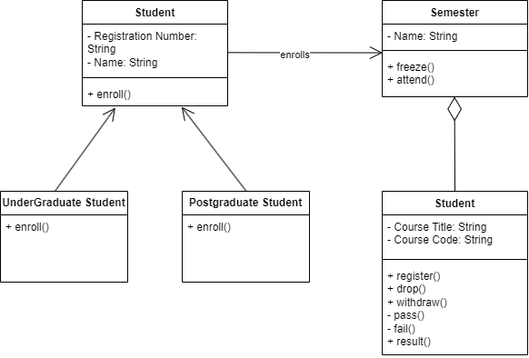


Class diagram

Slide 10
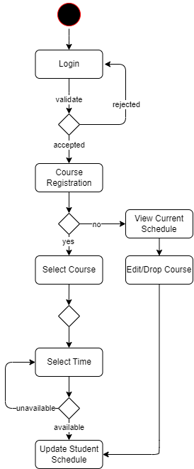
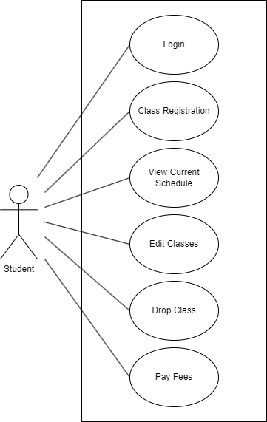
Activity diagram
Use Case diagram

Slide 11
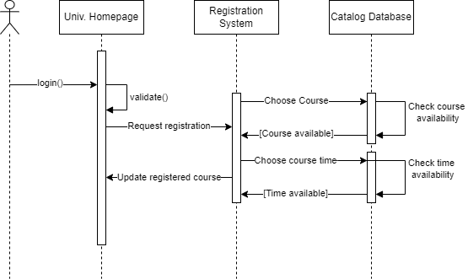
Sequence diagram

Slide 12
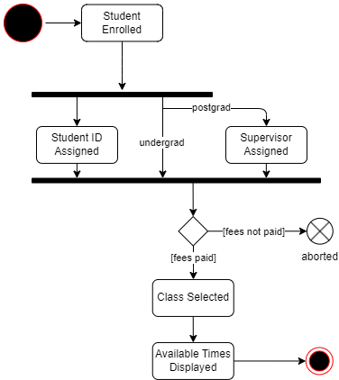
state diagram

Slide 13
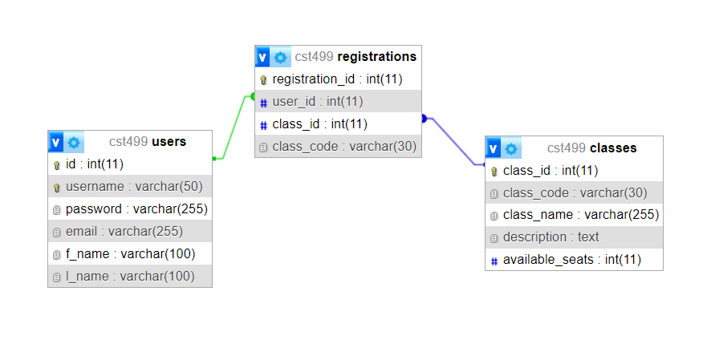
Database schema

Slide 14
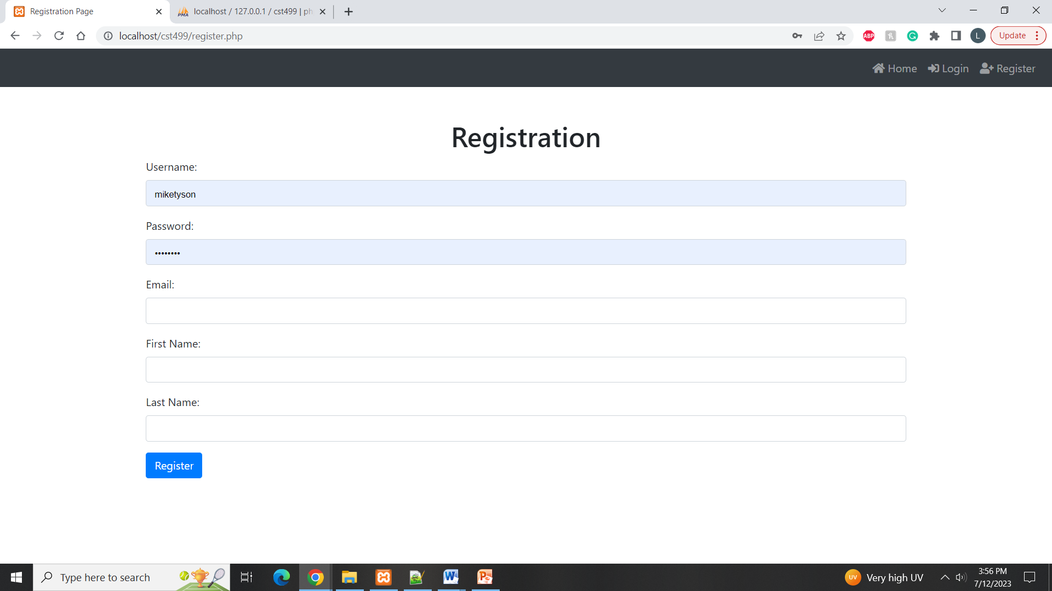
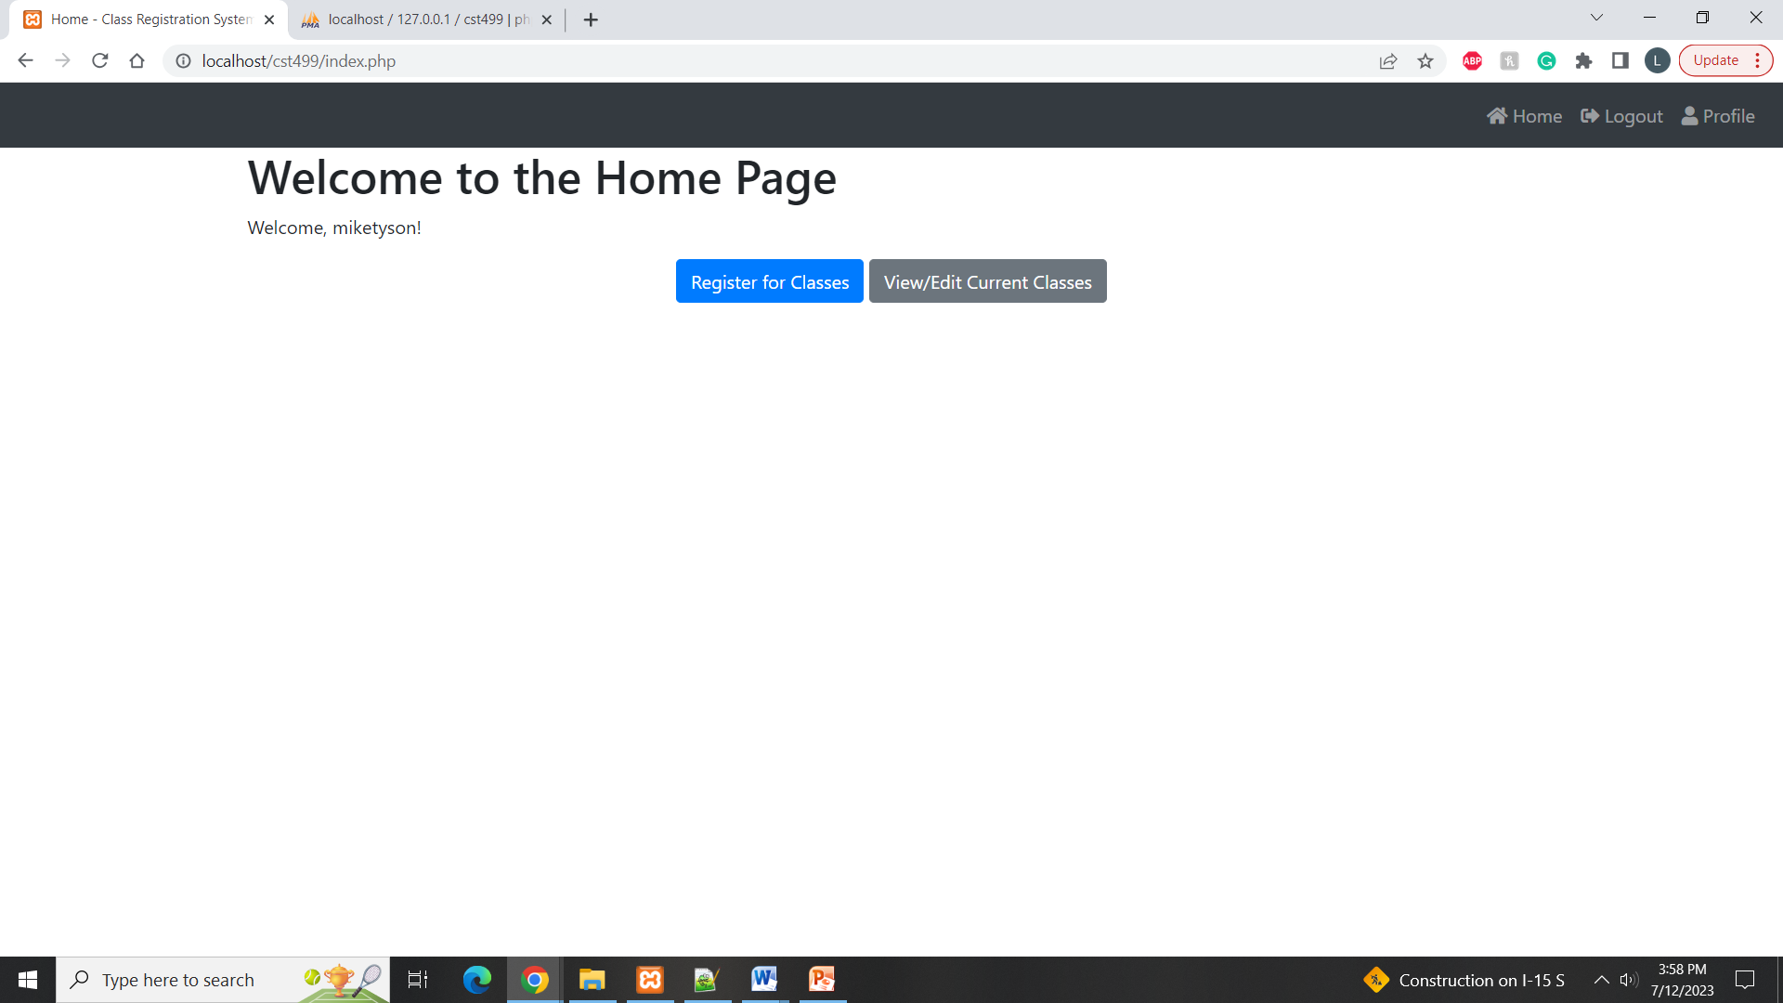
Registration page
Home page

Slide 15
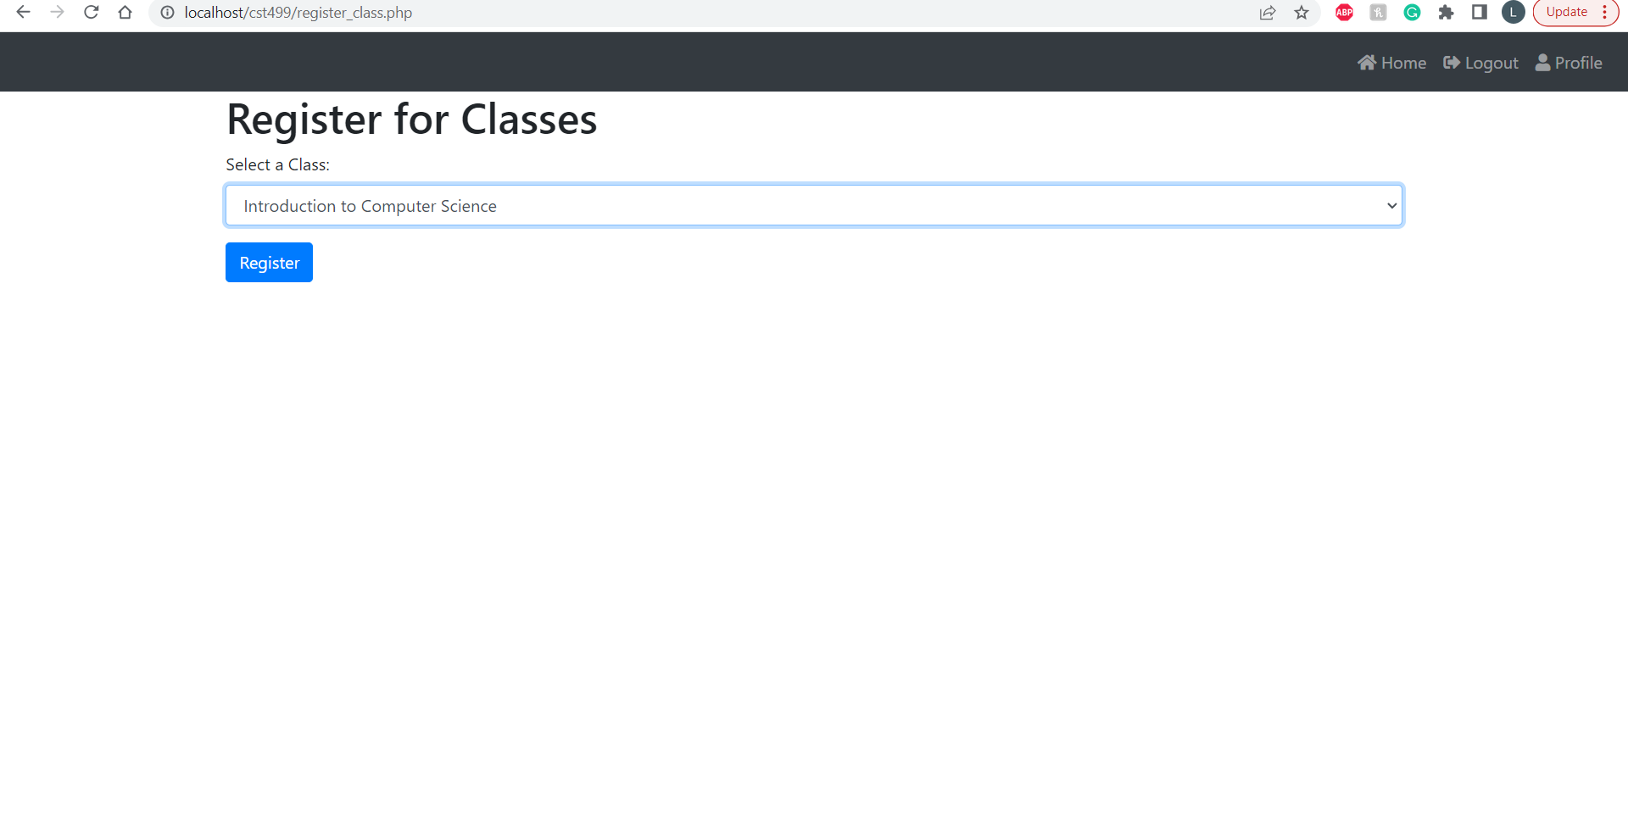
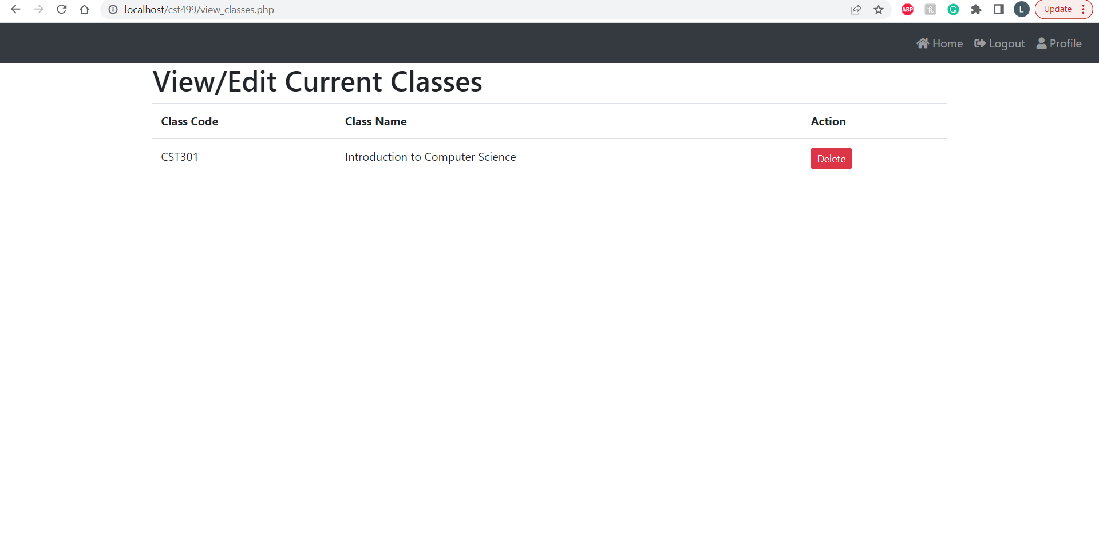
Registration page
classes page

Slide 16
References
Connolly, R., & Hoar, R. (2018). Fundamentals of web development (2nd ed.). Pearson.
Setiawan, R., Rasjid, Z. E., & Effendi, A. (2018). Design metric indicator to improve quality software developmentLinks to an external site. (Study case: Student desk portal). Procedia Computer Science, 135, 616–623. https://doi.org/10.1016/j.procs.2018.08.225
Tsui, F., Karam, O., & Bernal, B. (2018). Essentials of software engineering (4th ed.). Jones & Bartlett Learning.

